Slide 1



Faculty of Engineering – Cairo University
Smart Lock Using Arduino & Keypad
Presented by
Guided by
Moamen Wael
Kirollos Sabry
Moayad Ahmed
Kirollos Safwat
Loay Ashraf
Kevin Ramy
Kirollos Medhat
Marcilino Adel
Kirollos Bebawy
Kirollos Magdy
Eng. Yasser Hamed
Submitted for the partial fulfillment
of
the Requirements for
GEN0001 Practical and Engineering Applications (Physics part)
Preparatory Department
May - 2022

Slide 2
Content
Abstract
System description
Components
Stand by
Wrong Password
Wait 10 seconds
Right Password
Applications
Future scope
Conclusion
1 slide / 1 person
Smart Lock Using Arduino & Keypad
May - 2022
2

Slide 3

1. Abstract
There is no doubt that we need to defend our privacy from prying eyes in our daily life. So, we decided to present an effective solution to the current issue that has the best of the both worlds, security and effectiveness.
Our project is a smart lock that is composed of an Arduino microcontroller which controls a mechanical lock according to the password entered by user using a keypad and displayed instructions on a screen.
Smart Lock Using Arduino & Keypad
May - 2022
3

Slide 4
2. System description
First, we will plug our project with an electricity with AC to DC power supply adapter 9V 1A. Then, we will need to enter the password using the keypad [ The password can be letters (from A to C) and/or symbols (* or #) and/or numbers (from 0 to 9) ] Then press button “D” ( like an Enter button when entering your password in any website ). So, there will be 2 cases:
Case 1: The password is correct:
if the password entered matches the password already fixed in the code, the keypad will send a signal to the LCD display and the “Correct password” message will appear on it and the Arduino will send a signal to Servo Motor (Which is connected to the door with a metal wire). The Motor will then rotate 90° allowing the door lock to be unlocked. Then you will need to put a wrong password after entering to lock the door lock again or lock it manually , so that the motor will rotate 90° but in the opposite direction.
Case 2: The password is incorrect:
If the password inserted in the Keypad does not match the fixed password in the code, the Keypad will send a signal to the Display to show the “Wrong Password” message and the door lock won’t open. And we will need to wait 10 seconds to try again entering the password. Pressing the wrong values again in the Keypad will automatically instruct the user to start once again from the beginning. If the “Wrong Password” message is shown, the Servo Motor won’t rotate allowing the door lock to remain locked.
Smart Lock Using Arduino & Keypad
May - 2022
4

Slide 5
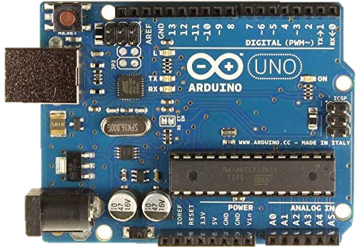
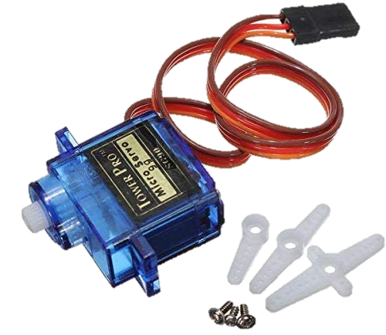
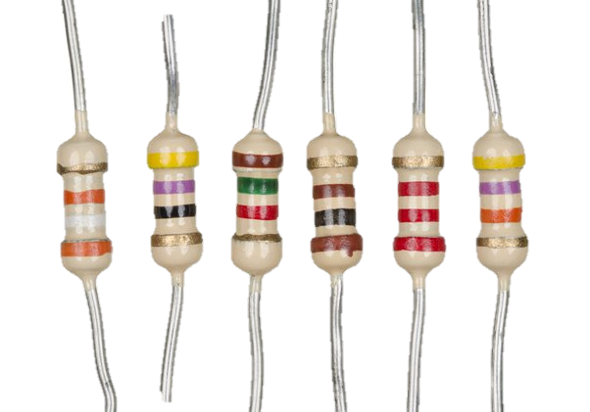
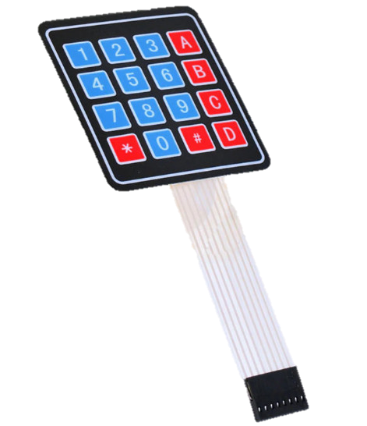
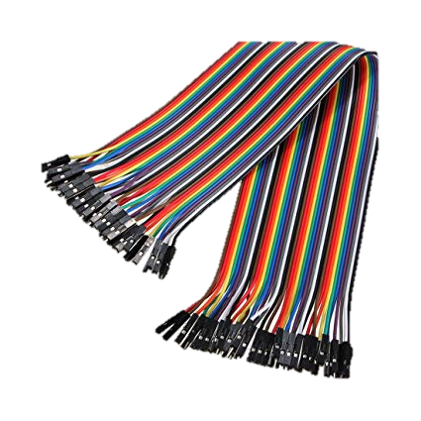
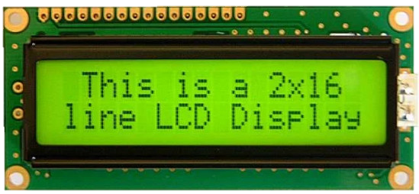
3. Components
Arduino
4x4 Keypad
Servo motor
16x2 LCD
Resistors
Jumpers
Smart Lock Using Arduino & Keypad
May - 2022
5

Slide 6
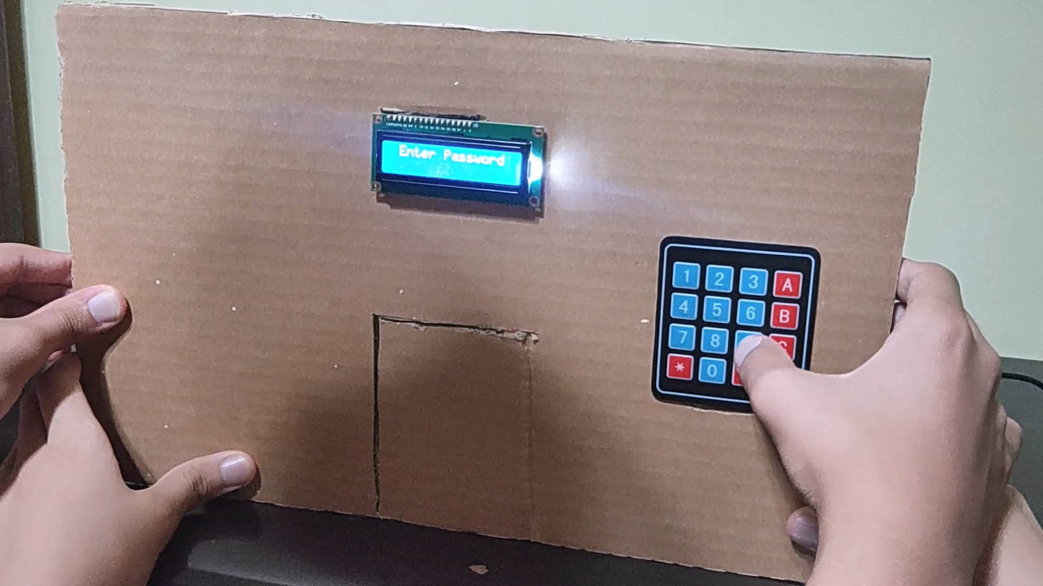
4. Stand by
That’s how the Arduino is waiting for the user to enter the password.
Smart Lock Using Arduino & Keypad
May - 2022
6

Slide 7
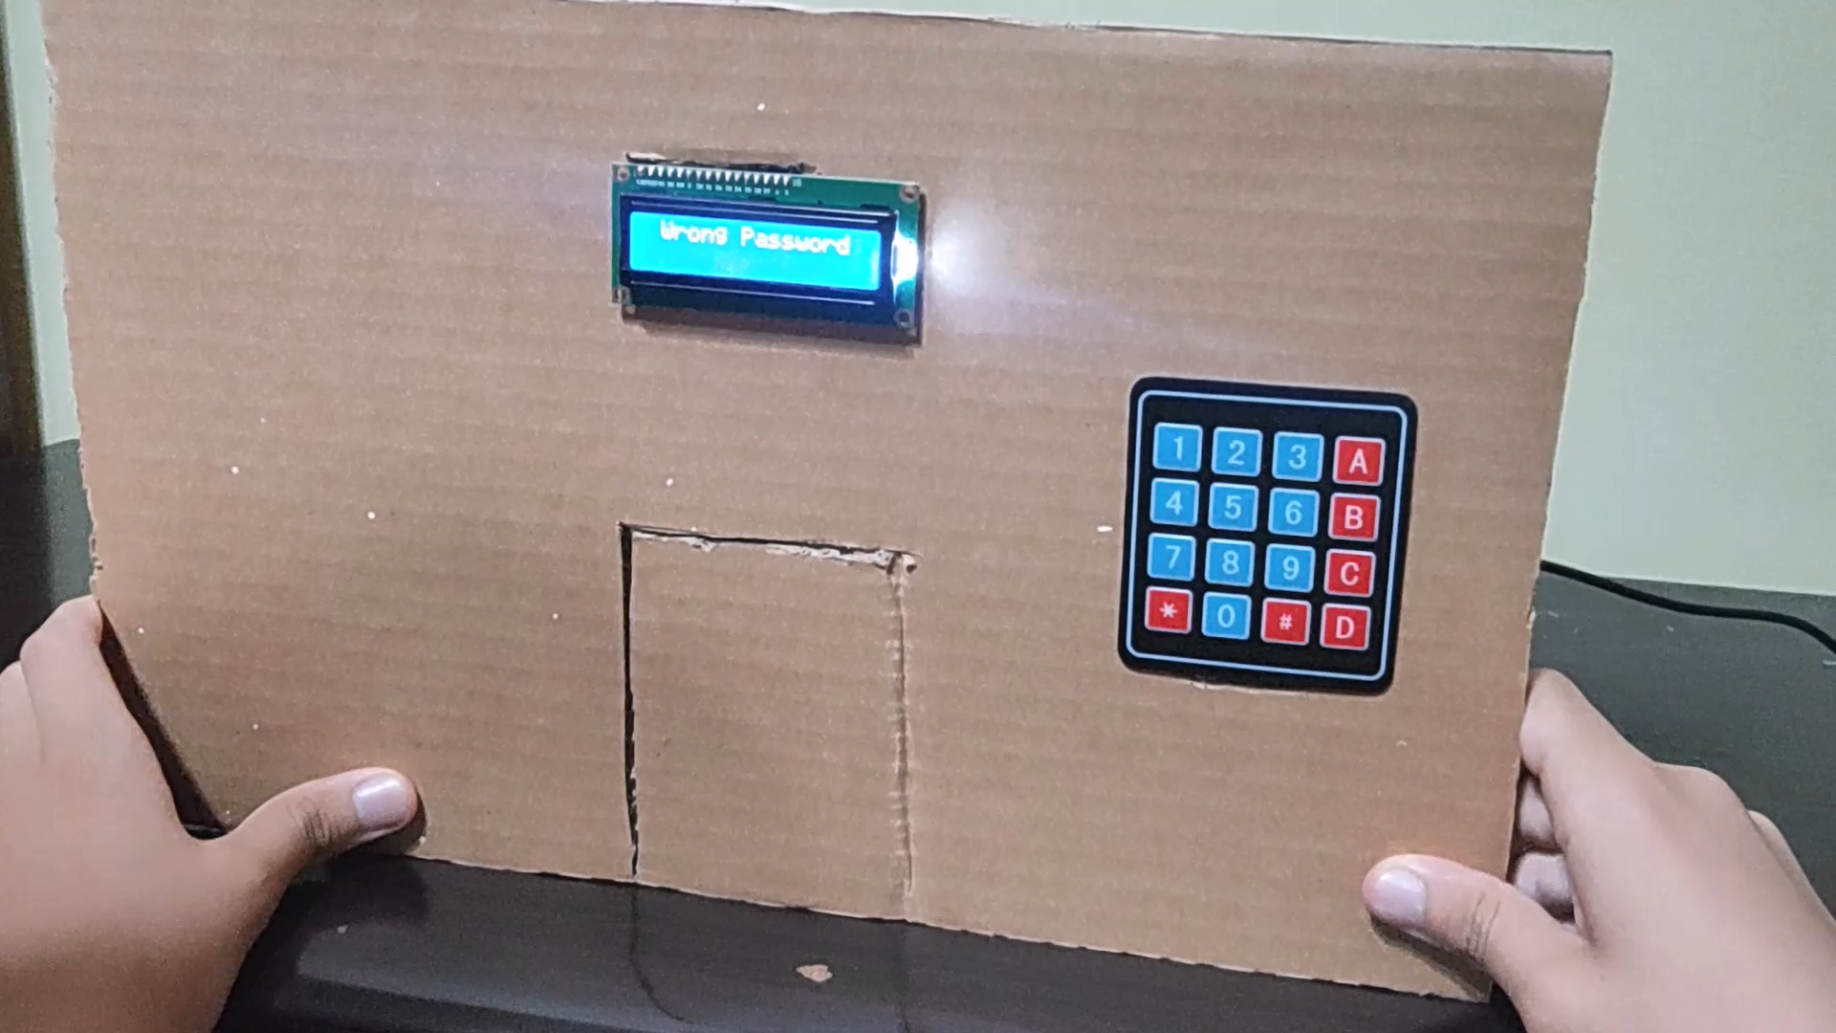
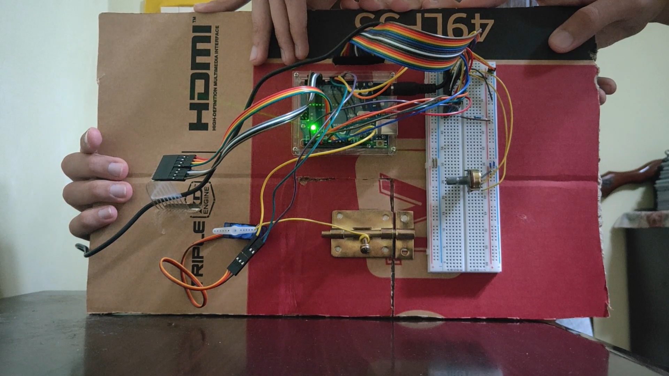
5. Wrong Password
If the user enters a wrong password the lock gets closed. Meanwhile, the screen displays an instructive message.
Smart Lock Using Arduino & Keypad
May - 2022
7

Slide 8
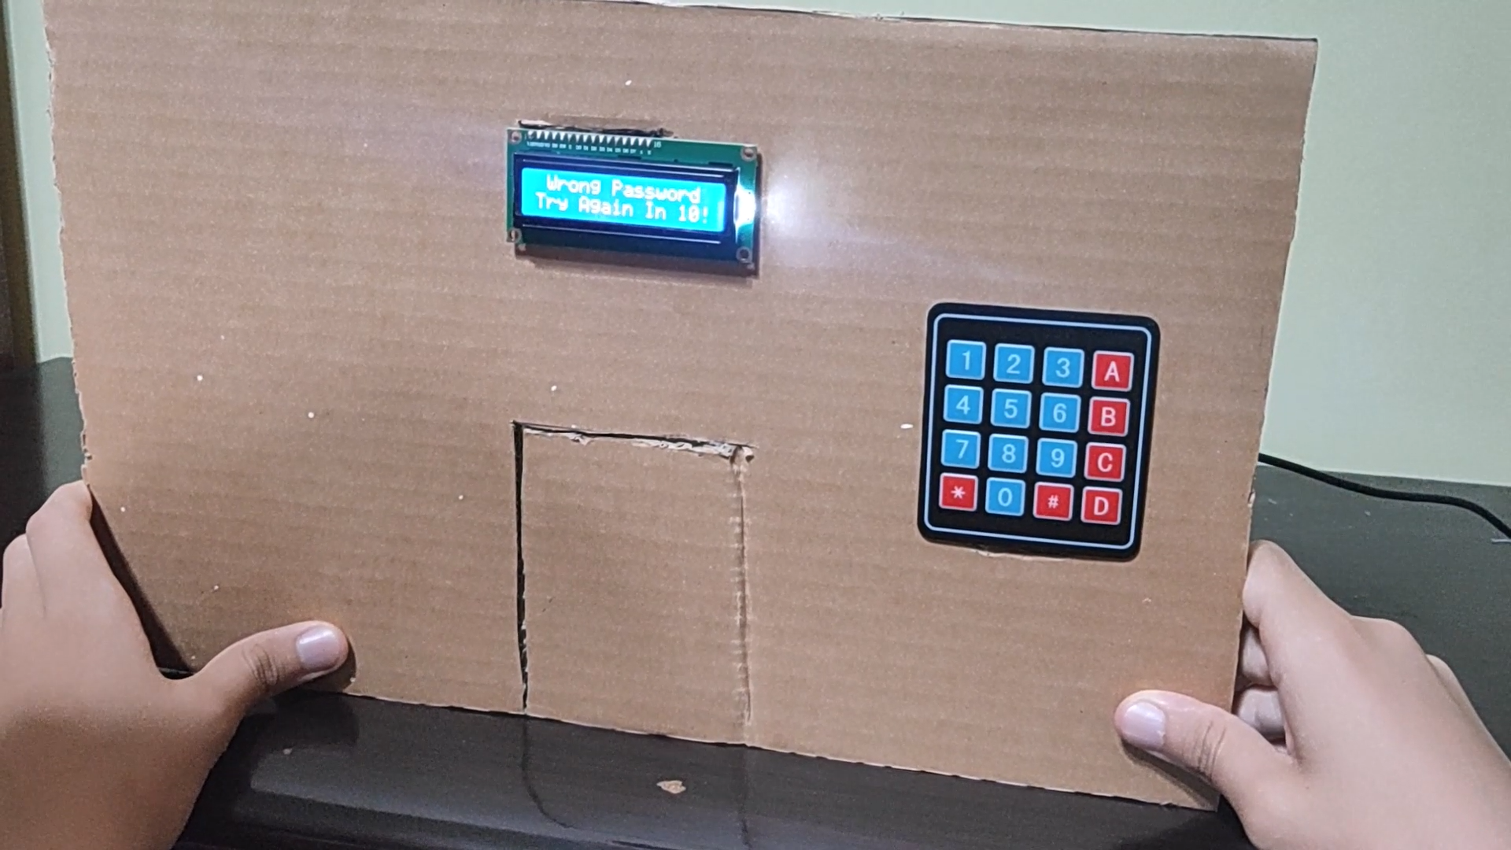
6. Wait 10 seconds
Moreover, after submitting a wrong password, the user should wait for 10 seconds. This step is indispensable for the protection against the unauthorized guesses.
Smart Lock Using Arduino & Keypad
May - 2022
8

Slide 9
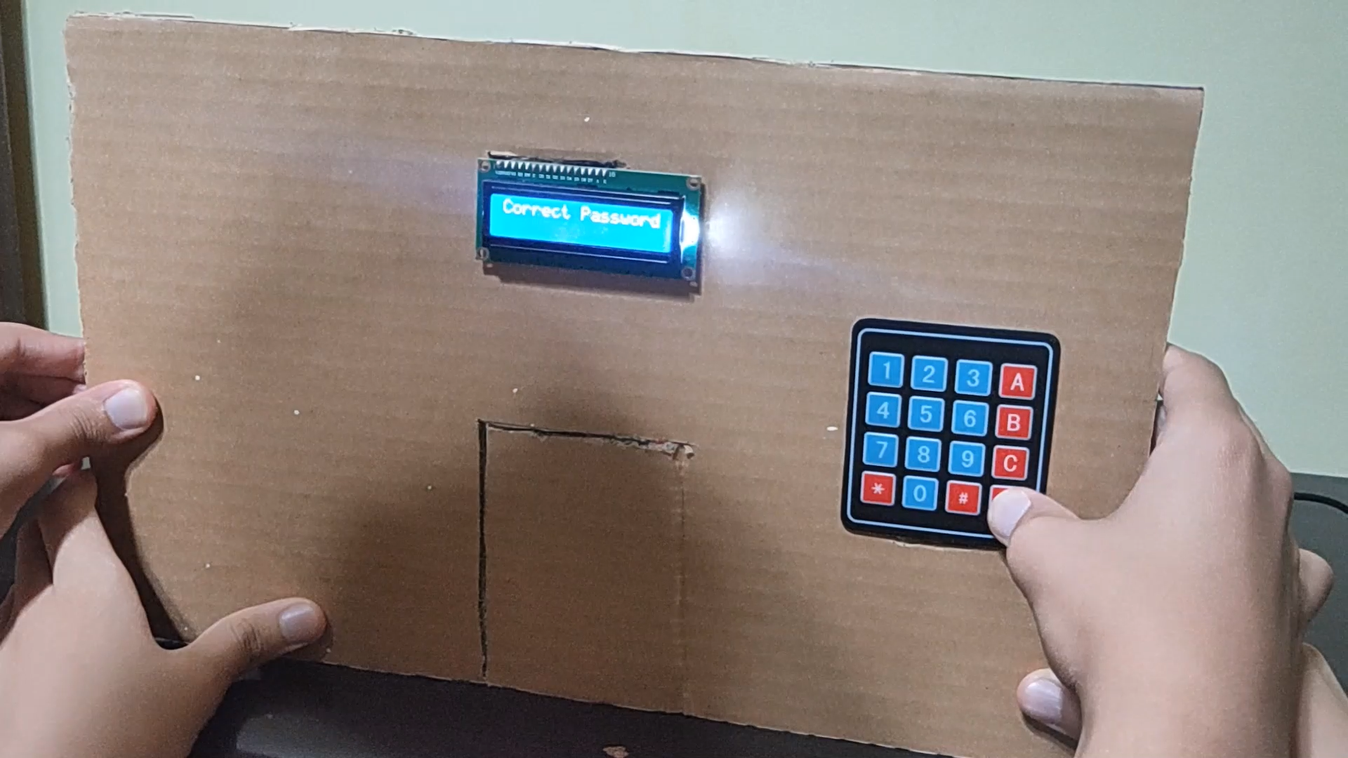
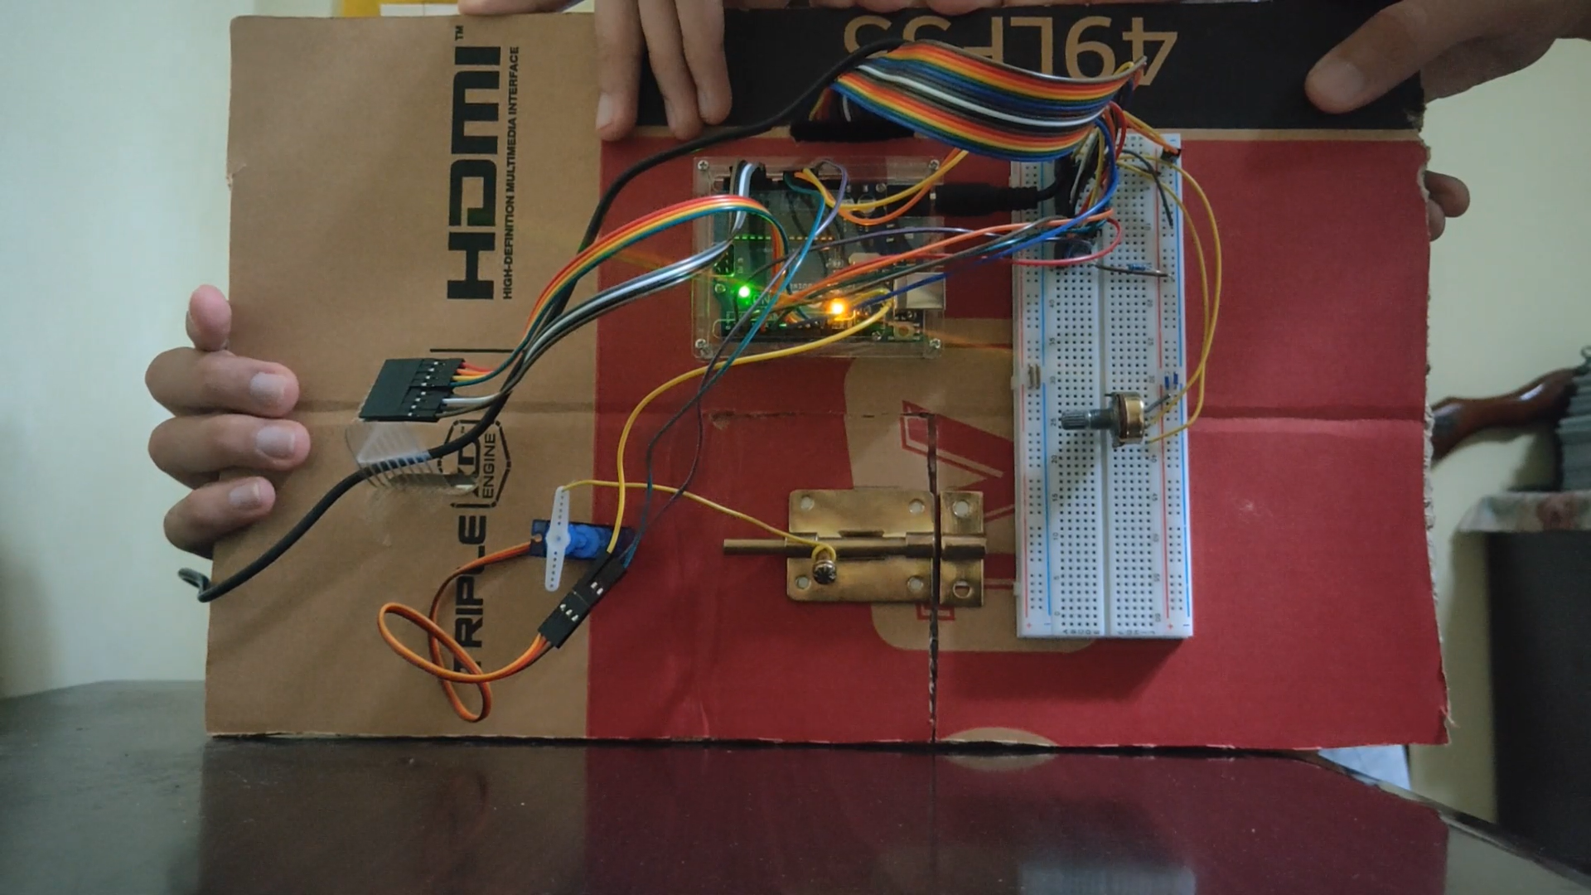
7. Correct Password
In this case, user enters the required password. Consequently, the lock opens and as always the screen acts as an illustrative guide.
Smart Lock Using Arduino & Keypad
May - 2022
9

Slide 10

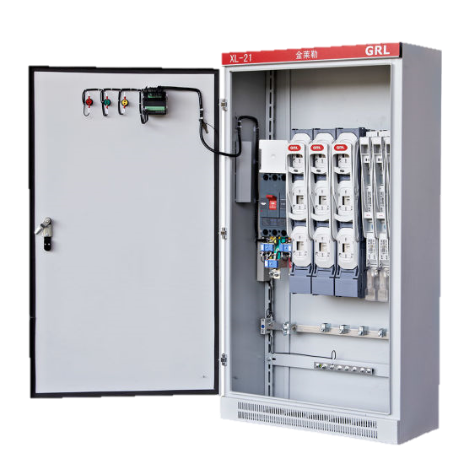
8. Applications
Personal use
Doors
Maintenance Works Safety
Smart Lock Using Arduino & Keypad
May - 2022
10

Slide 11
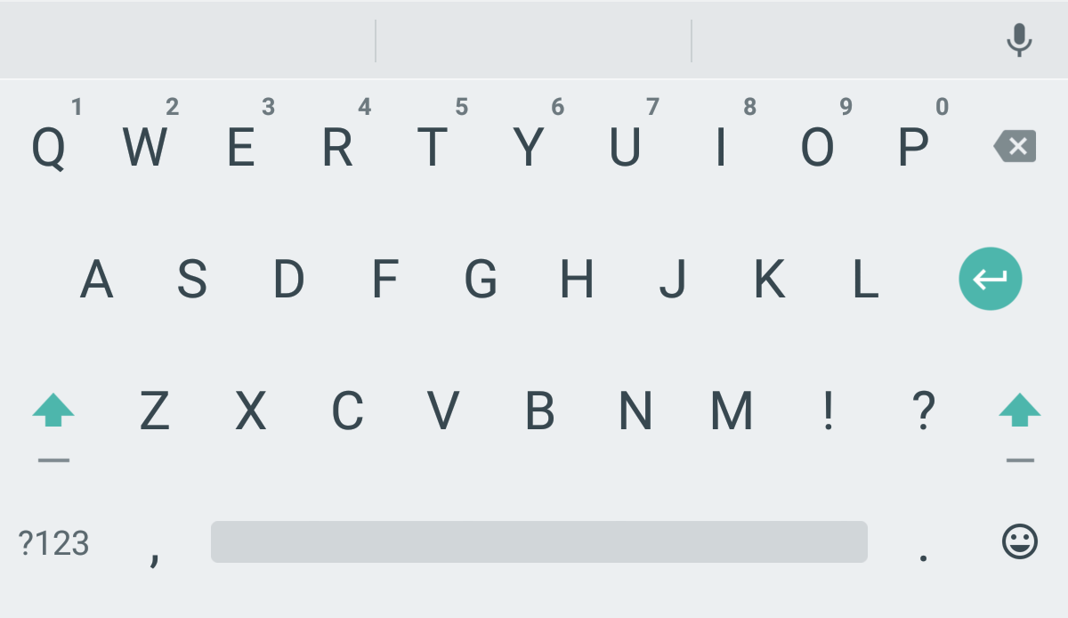

9. Future Scope
In The Future many features can be added as:
Multiple Characters
Biosensors like retinal scan, fingerprint,...etc.
Easy installation methods
A method for Resetting password
Smart Lock Using Arduino & Keypad
May - 2022
11

Slide 12


10. Conclusion
Using simple materials and tools, project objectives were successfully achieved. The present lock represents a well-made solution for anyone who seeks security at an affordable price.
Furthermore, mass production can be accomplished using modern manufacturing process to produce many locks in very short time in addition to increasing accuracy and decreasing the cost per product even more.
Smart Lock Using Arduino & Keypad
May - 2022
12

Slide 13


